Slide 1
Unit 2: Electric Charge, Voltage & Current
Part C: Current

Slide 2
What will you learn?
What is current?
How current is quantitatively defined?
What is the difference between conventional current direction and electron current direction?

Slide 3
What is Current?
-
-
-
-
-
-
-
-
-
-
-
-
-
-
-
-
-
-
-
-
-
-
-
-
In the absence of an external voltage source, free electrons move randomly inside the conductor.
Notes:
Free electrons in a conductive material drift randomly in the absence of a voltage

Slide 4
What is Current?
_
+
Low
Potential
High Potential
-
-
-
-
-
-
-
-
-
-
-
-
-
-
-
-
When a voltage is applied, electrons move in an orderly fashion.
Notes:
When a voltage is applied between 2 ends of the wire, energy is available for electrons to move in a fixed direction
When electrons move, current is said to flow.
Electrons flow out from the negative terminal of the voltage source, through the conductor, and return to the positive terminal.

Slide 5

Current
The magnitude of an electric current is determined by how much charge flowing per sec.
-
-
-
-
-
-
-
-
-
-
-
-
-
-
$$Current=\frac{Charge}{Time}$$
$$I=\frac{Q}{t}$$

Slide 6
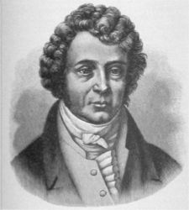
Unit & Symbol
Current is measured in amperes (or amps in short) named after the French physicist Marie Andre Ampere.
The unit symbol is A.
A current of 1 A means that the electric charge moves at a rate of 1 C per second.
Marie Andre Ampere
Notes:
Think of how can you can increase current from 1A to 2A? Pause.
Either double the no. of charges flowing per second or allow 1 C of charges to flow through in 0.5 seconds

Slide 7

Example 1
15 C of charge passes through a given point in a circuit in 3 s. What is the magnitude of the current?
$$I=\frac{Q}{t}=\frac{15 C}{3 s}=5 A$$
Notes:
15 coulombs of charge

Slide 8
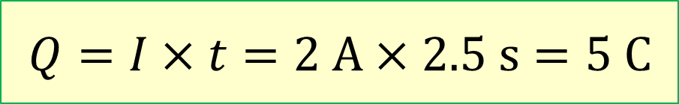
Example 2
The current flows through the filament of a lamp is 2 A. How much charge moves through the filament in 2.5 s?
$$Q=I×t=2 A×2.5 s=5 C$$

Slide 9
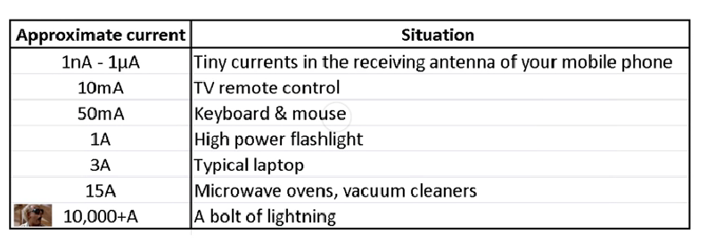
Typical Current Values

Slide 10
Electron Current vs. Conventional Current
Conventional current direction
Electron Current direction
High Potential
+
_
+
_
Electron
current flow
Conventional
current flow
V
V
Low
Potential
Conventional Current is used throughout this course

Slide 11
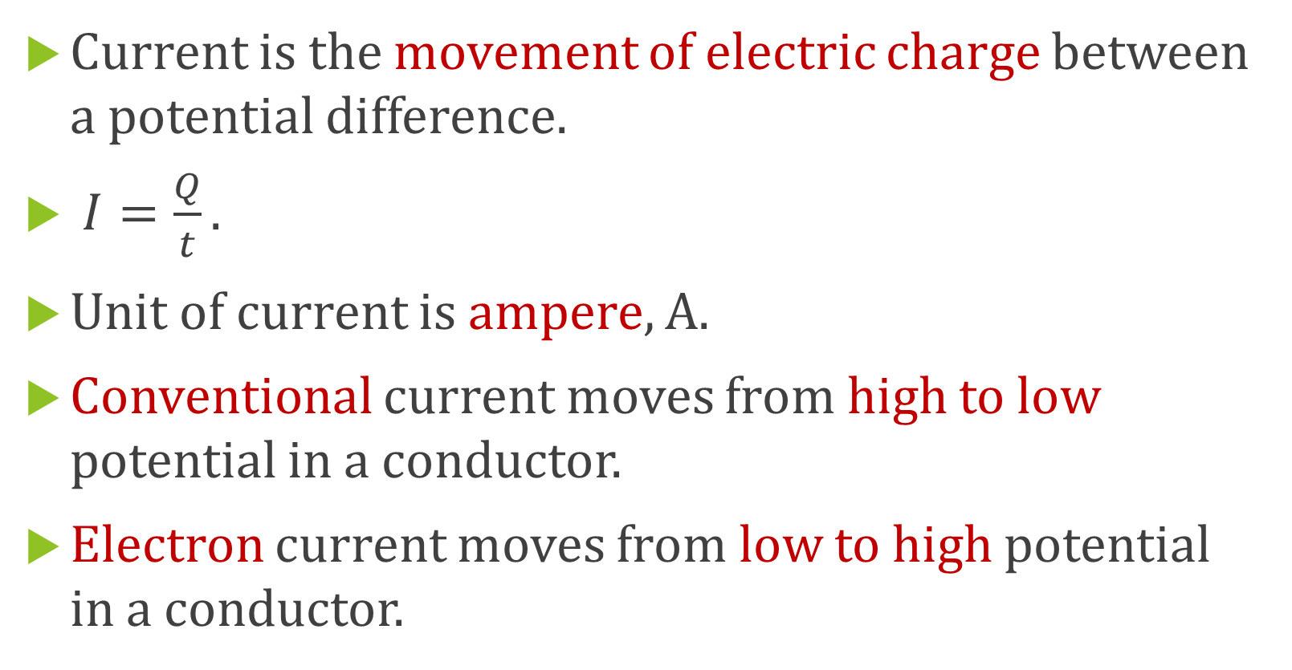
What have you learned?
Current is the movement of electric charge between a potential difference.
$I=\frac{Q}{t}.$
Unit of current is ampere, A.
Conventional current moves from high to low potential in a conductor.
Electron current moves from low to high potential in a conductor.

Slide 12
What’s coming up next?
Unit 3 Part A, Resistance.

